Slide 1
Unlocking Potential: Changing Lives
Notes:
1

Slide 2
Vision Statement
The Central Learning Partnership Trust is underpinned by a moral purpose:
to change lives for the better.
We are committed to:
Improving the life chances of our young people
Optimising their feeling of self-worth
Developing their resilience and in turn their capacity to embrace the challenges that lie ahead
Above all else, we encourage students to be ambitious for themselves, their families and their communities.

Slide 3
Vision Statement
We believe:
Success is the birth-right of every individual
Schools must be relentless in their drive to ensure this is delivered
We are determined:
To challenge the premise that education alone cannot break the cycle of
deprivation – low aspirations and resultant low outcomes
To eradicate the poverty of expectation
To instil in every member of our school communities a personal resolve and drive to succeed
To create a ‘Yes We Can’ mentality

Slide 4
Partner Schools

Slide 5
Central Learning Partnership Trust
Heath Park became an academy in December 2011
Moseley Park – academy status June 2012 (sponsor-led)
Woden Primary – academy status April 2013 (sponsor-led)
Coleridge Primary (Rotherham) – academy status April 2013 (sponsor-led)
East Dene Primary (Rotherham) – academy status April 2013 (sponsor-led)

Slide 6
Joined the Trust 2015 and 2016
Eastwood Village Primary - September 2015 (Basic Needs funded new build)
Wolverhampton Vocational Training Centre, 16 – 18 Special School – September
2015 (Free School)
Westcroft School – academy status December 2015 (converter)
Broadmeadow Special School – academy status December 2016 (converter)

Slide 7
Joined the Trust: Spring/Summer 2018
D’Eyncourt Primary School: academy status April 2018 (converter)
Coppice Performing Arts School: academy status June 2018 (sponsor-led)

Slide 8
Strategic Priorities
Our strategic priorities are underpinned by the following:
The creation of collaborative school improvement systems
Optimising the capacity of the present backroom structure
Maximising the funding into individual academies
Focussing on our core business – continuous school improvement

Slide 9
Structural Collaboration
The benefits:
Maximises the impact of all resources on all students
Working in partnership with resources following need
Best practice shared across partnership schools
A joint approach to recruitment, training and retention - TSA
Additional career development opportunities
Building capacity
Succession planning

Slide 10
How much have the academies within CLPT improved over the last three years?
What has the Trust contribution been to this?

Slide 11
Ofsted Inspections
School | Date | Outcome
Heath Park | 26-27 February 2014
Woden Primary | 10-11 March 2015

Slide 12
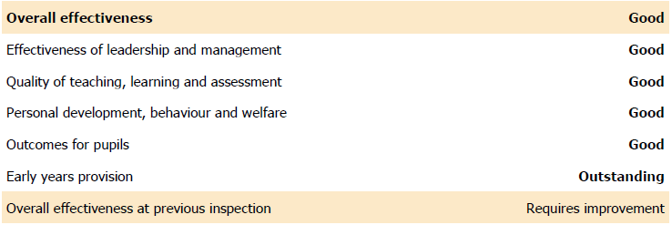
Ofsted Inspections
School | Date | Outcome
East Dene | 03-04 May 2017
Coleridge | 04-05 July 2017

Slide 13
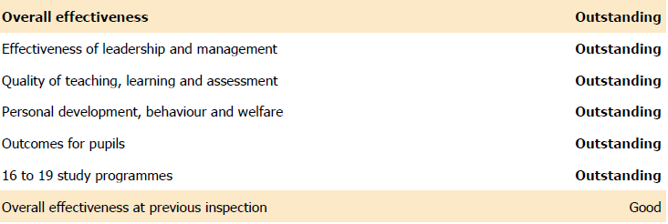
Ofsted Inspections
School | Date | Outcome
Moseley Park | 19-20 September 2017
WVTC | 05-06 June 2018 | Currently awaiting outcome.

Slide 14
Primary Performance
Top Performing Primary MAT in the country (2016) and one of only seven with all three KS2 Progress
Measures judged significantly above national average.
 | Performance measure (7) |  |  | Performance measure (7) |  |  | Performance measure (7)
MAT name | Key stage 2 reading progress measure |  |  | Key stage 2 writing progress measure |  |  | Key stage 2 maths progress measure
The Central Learning Partnership Trust | Significantly above average | 5.1 | (3.9 to 6.3) | Significantly above average | 5.9 | (4.7 to 7) | Significantly above average | 6.1 | (5.1 to 7)
Harris Federation | Significantly above average | 2.5 | (2 to 3) | Significantly above average | 3.6 | (3.1 to 4.2) | Significantly above average | 3.3 | (2.9 to 3.8)
Hull Collaborative Academy Trust | Significantly above average | 2.5 | (1.7 to 3.4) | Significantly above average | 3.9 | (3 to 4.7) | Significantly above average | 2.6 | (1.9 to 3.3)
Outwood Grange Academies Trust | Significantly above average | 1.8 | (0.6 to 3) | Significantly above average | 7.8 | (6.5 to 9) | Significantly above average | 4.2 | (3.1 to 5.2)
Tudhoe Learning Trust | Significantly above average | 1.1 | (0.1 to 2.1) | Significantly above average | 3.6 | (2.6 to 4.6) | Significantly above average | 1.8 | (1 to 2.7)
Kemnal Academy Trust, The (TKAT) | Significantly above average | 0.5 | (0.1 to 0.9) | Significantly above average | 0.4 | (0.1 to 0.8) | Significantly above average | 0.8 | (0.5 to 1.2)

Slide 15
Secondary Performance
School | Progress 8 Score | Description | Attainment 8 | National | Progress 8 Score | Description | Attainment 8 | National
 | 2015/16 |  |  |  | 2016/17
Heath Park | 0.41 | Above Average | 54.34 | 49.5 | 0.47 | Above Average | 51.45 | 44.62
Moseley Park | 0.53 | Well Above Average | 51.97 | 49.5 | 1.07 | Well Above Average | 49.86 | 44.62

Slide 16
Trust Contribution:
Partnerships
All of the above, are the result of partnership and true collaborative working, achieved through the establishment of formal School Improvement Hubs.
Not a pre-requisite or result of academy conversion
BUT
An alternative way of working and your choice to make

Slide 17
Partnerships
How would CLPT build on the strengths of new partners?
Recognition and acknowledgement of strengths of partner schools
Audit of strengths and development needs across all schools within an improvement hub and/or collaborative
Action planning and co-ordination of resources across partnership
Working collaboratively to add value

Slide 18
Partnerships
Evolving relationships as converter academies join the trust:
To enhance an existing school improvement hub
To lead ‘arms’ of the trust
Lead school within a school improvement hub
Provide trust-wide expertise in specific areas
Adding value and leadership capacity
Staffing

Slide 19
Partnerships
Secondary School Improvement Hub
Subject Groups – in-house support, joint planning, moderation, target setting and progress monitoring, subject specific CPD etc
Leadership Groups – supporting new initiatives: from policy to practice
Sharing of good practice at all levels and in all areas
In-house inclusion solutions
Student Events

Slide 20
Protecting Uniqueness
Uniqueness of individual academies is fiercely protected:
No cloning
Build on strengths of individual academy partners
Enhances breadth of provision across partnership
Shared resources across and between partnerships
Sufficient space in curriculum to accommodate specialisms

Slide 21
Governance
CLPT Trust Board:
Eight Trustees with plans for further expansion
Ultimate responsibility for financial sustainability and educational outcomes across all partner academies
Trust Board committees: Finance and Personnel Committee, Audit and Risk Committee
CEO, Finance Director and Operations Director

Slide 22
Governance
Each school or group of schools have their own Local Governing Body or Local Executive Governing Body with accountabilities broadly in line with those of a maintained school:
Standards and Effectiveness
Strategic Planning
Recruitment and deployment of staff
Safeguarding
Budget setting and review process
Two Trust nominees sit on LGBs / LEGBs
CLPT Governance Delegation matrix outlines level of responsibility of Trust Board, CEO, Trustees, LGBs LEGBs and Headteachers

Slide 23
Core Support
Legal, Statutory and Regularity Compliance
Trust wide policy development
Payroll – the Trust operates its own centralised Payroll service
Finance support
HR – support for recruitment, grievance, disciplinary, absence monitoring, industrial relations, terms and conditions, restructures and salary issues
Creative Services – assistance with design, production and publication of a variety of materials e.g. school prospectus, website design, enhancing learning environments
ICT infrastructure – systems development, technical support and development, troubleshooting
Facilities Management
Marketing and Communications – management of communications with third parties

Slide 24
Education Support
school to school partnership support
NLE,NLG, SLE support
Trust-wide ‘champions’ support
SLT support
departmental support
access to national leadership development programmes
TSA support and career opportunities
ITT through our own Schools Direct programme
head teachers and executive head teachers forum
joint training opportunities
NQT and RQT support

Slide 25
Economies of Scale
Presently CLPT has ten academies and one Free School in the Trust. Any increase in member schools will not require additional central staff/cost, as we have reached a level at which we can begin to optimise economies of scale. As the Trust increases the number of member academies, the economies of scale will enable a reduction in individual contributions. DfE research shows no further investment in central support required until a trust exceeds twenty schools.
What this means is:
Greater job security – as more money goes to support ‘core business’
Enhanced career opportunities – cross-hub roles
Succession Planning through Job Shadowing
Bespoke CPD to facilitate capacity building
Better placed to minimise impact of National Funding Formula

Slide 26
Unlocking Potential: Changing Lives
Notes:
26

